Slide 1
Linear Algebra
Lecture 26

Slide 2
Vector Spaces

Slide 3

Definition
Suppose the set B = {b₁, …, b_{n}} is a basis for V and x is in V. The coordinates of x relative to the basis B (or the B-coordinates of x) are the weights c₁, … , c_{n} such that

Slide 4
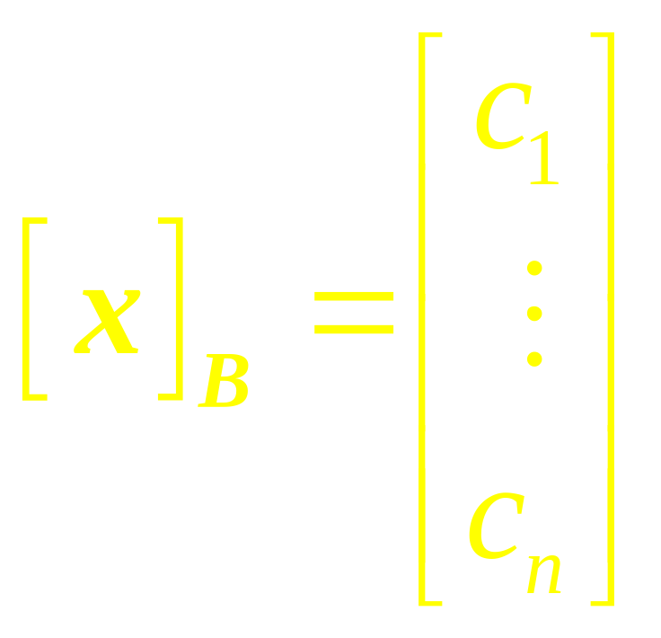
If c₁,c₂,…,c_{n} are the B-Coordinates of x, then the vector in R^{n}
is the coordinate of x (relative to B) or the B-coordinate vector of x. The mapping x → [x]_{B} is the coordinate mapping (determined by B)

Slide 5
Dimension
A vector space with a basis B containing n vectors is isomorphic to R^{n}.
‘n’ is intrinsic property called Dimension

Slide 6
Change of Basis

Slide 7
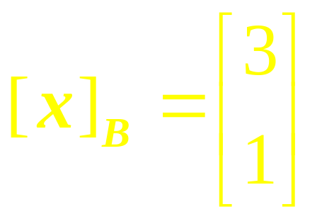
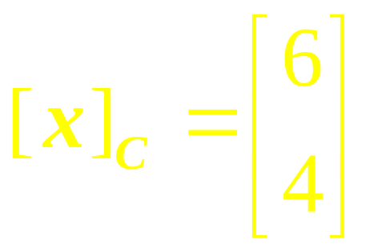
Observe
x = 3b₁ + b₂
x = 6c₁ + 4c₂
Our problem is to find the connection between the two coordinate vectors.

Slide 8
Two Coordinate Systems
for same vector space
3c₂
b₂
c₂
0
x
c₁
x
b₁
3b₁
4c₁

Slide 9
Example 1
Consider two bases B = {b₁, b₂} and C = {c₁, c₂} for a vector space V, such that
b₁= 4c₁ + c₂ and b₂ = -6c₁ + c₂
Suppose that x = 3b₁ + b₂
…

Slide 10
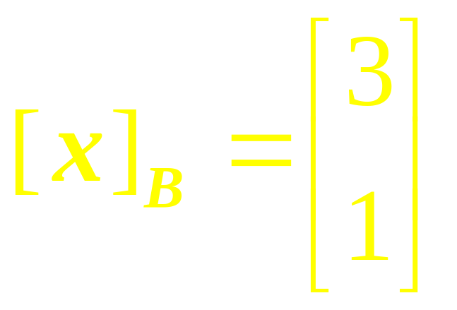
continued
That is, suppose that
Find [x]_{C} .
…

Slide 11
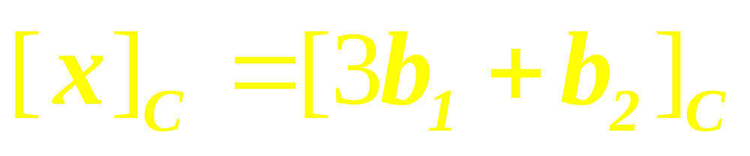

Solution

Slide 12
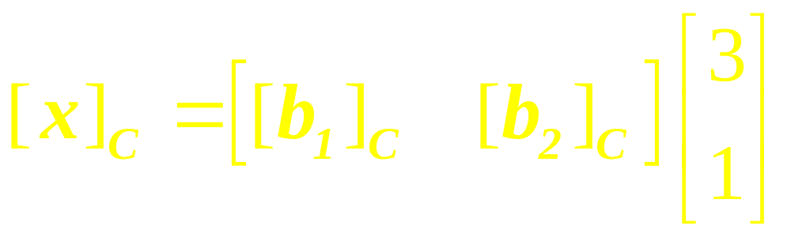
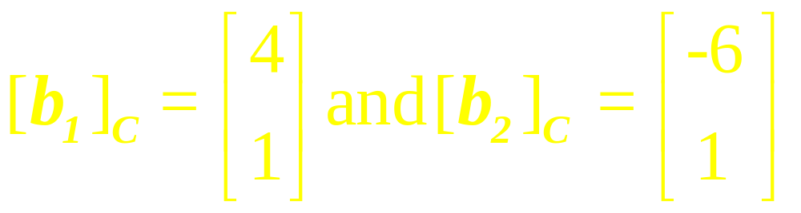
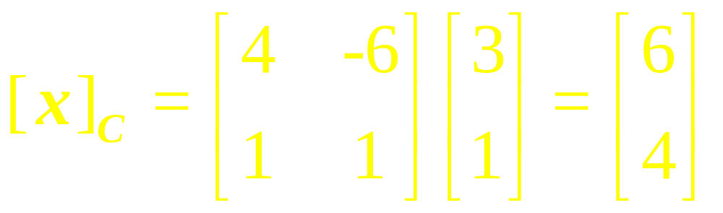

Slide 13

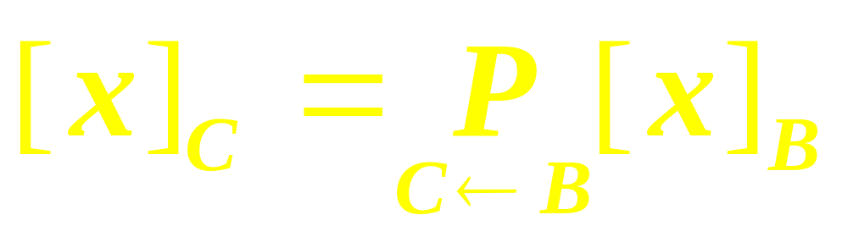
Theorem
Let B = {b₁, … , b_{n}} and
C = {c₁, … , c_{n}} be bases of a vector space V. Then there is an n x n matrix such that
…

Slide 14
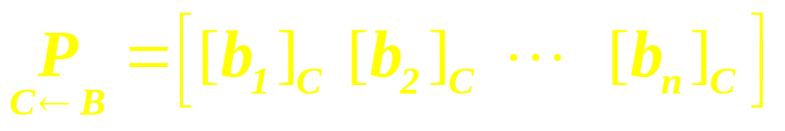
continued
The columns of
are the C-coordinate vectors
of the vectors in the basis B.
That is,
…

Slide 15
Note
The matrix is called the change of coordinate matrix from B to C. Multiplication by converts B-coordinates into C-coordinates
…

Slide 16
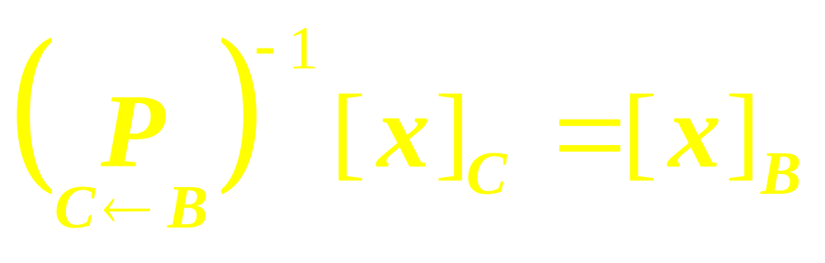
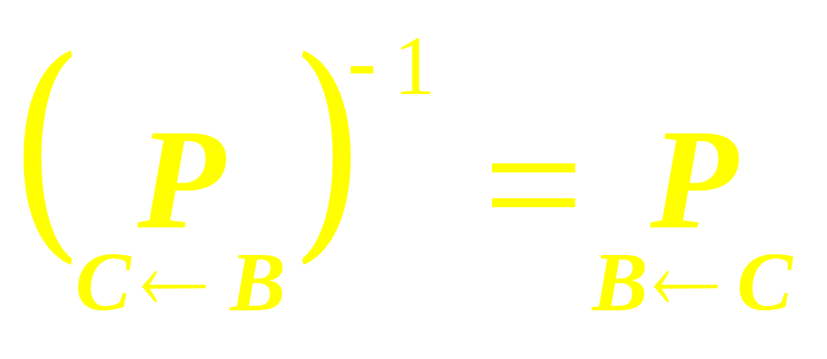
Observe

Slide 17
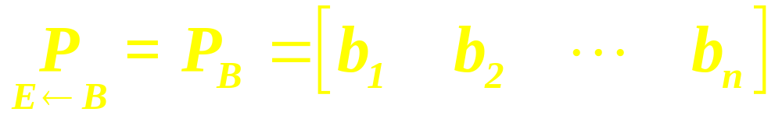
Change of Basis in R^{n}
If B = {b₁, …, b_{n}} and E is the
standard basis {e₁, … , e_{n}} in R^{n},
then [b₁]_{E} = b₁, and likewise for
the other vectors in B. In this
case,

Slide 18
Example 2
Let D={d₁, d₂, d₃} and
F={f₁, f₂, f₃} be basis for vector space V, and suppose that
f₁ = 2d₁- d₂ + d₃,
f₂ =3d₂ + d₃,
f₃ = -3d₁ + 2d₃.
…

Slide 19
continued
(1) Find the change-of
Coordinates matrix from F to D.
(2) Find [x]_{D} for
x = f₁ – 2f₂ + 2f₃.

Slide 20
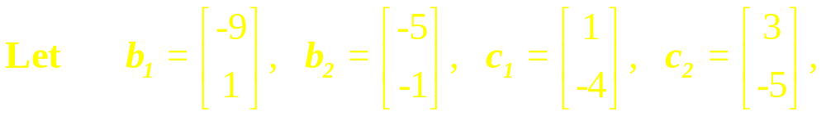
Example 3
and consider the bases for R²
given by B = {b₁, b₂} and
C = {c₁, c₂}. Find the change-of-
coordinates matrix from B to C.

Slide 21
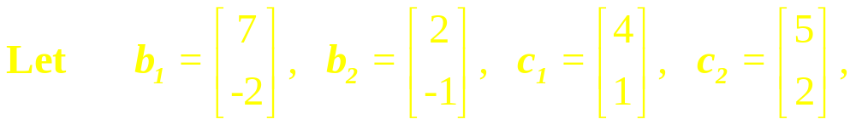
Example 4
and consider the bases for R²
given by B = {b₁, b₂} and
C = {c₁, c₂}. Find the change-of-
coordinates matrix from C to B
and also from B to C.

Slide 22

Example 5
and consider the bases for R²
given by B = {b₁, b₂} and
C = {c₁, c₂}. Find the change-of-
coordinates matrix from C to B
and also from B to C.

Slide 23
Example 6
1. Let F = {f₁, f₂} and G = {g₁, g₂}
be bases for a vector space
V, and let P be a matrix whose
columns are [f₁]_{G}. Which of the
following equations is satisfied by P for all v in V?
…

Slide 24
continued
(i) [v]_{F} = P[v]_{G} (ii) [v]_{G} = P[v]_{F}
2. Consider two bases
B = {b₁, b₂} and C = {c₁, c₂} for a vector space V, such that
b₁= 4c₁ + c₂ and b₂ = -6c₁ + c₂. Find the change-of-coordinates matrix from C to B.

Slide 25
Axioms of Vector Space
For any set of vectors u, v, w in V and scalars l, m, n:
1. u + v is in V
2. u + v = v + u

Slide 26
3. u + (v + w) = (u + v) + w
4. There exist a zero vector 0 such that
0 + u = u + 0 = u
5. There exist a vector –u in V such that
-u + u = 0 = u + (-u)

Slide 27
6. (l u) is in V
7. l (u + v)= l u + l v
8. m (n u) = (m n) u = n (m u)
9. (l+ m) u = I u + m u
10. 1u = u where 1 is the multiplicative identity

Slide 28
Definition
A subset W of a vector space V is called a subspace of V if W itself is a vector space under the addition and scalar multiplication defined on V.

Slide 29
Theorem
If W is a set of one or more vectors from a vector space V, then W is subspace of V if and only if the following conditions hold:

Slide 30
continued
(a) If u and v are vectors in W, then u + v is in W
(b) If k is any scalar and u is any vector in W, then k u is in W.

Slide 31
Definition
The null space of an m x n matrix A (Nul A) is the set of all solutions of the hom equation Ax = 0
Nul A = {x: x is in R^{n} and Ax = 0}

Slide 32
Definition
The column space of an m x n matrix A (Col A) is the set of all linear combinations of the columns of A.

Slide 33
Definition
The column space of an m x n matrix A (Col A) is the set of all linear combinations of the columns of A.

Slide 34

Definition
An indexed set of vectors {v₁,…, v_{p}} in V is said to be linearly independent if the vector equation
has only the trivial solution,
c₁=0, c₂=0,…,c_{p}=0

Slide 35
Definition
The set {v₁,…,v_{p}} is said to be linearly dependent if (1) has a nontrivial solution, that is, if there are some weights, c₁,…,c_{p}, not all zero, such that (1) holds. In such a case, (1) is called a linear dependence relation among v₁, … , v_{p}.

Slide 36
Definition
Let H be a subspace of a vector space V. An indexed set of vectors
B = {b₁,…, b_{p}} in V is a basis for H if
…

Slide 37
continued
B is a linearly independent set, and the subspace spanned by B coincides with H; that is,
H = Span {b₁,...,b_{p} }.

Slide 38
Linear Algebra
Lecture 26

